Slide 1

Data-Driven Fare and Duration prediction with Peak hour classification for NYC Taxi Trips
Group D
Team Members:
Tejaswini Penneni
Shiva Shankar Kanike
Soniya Koduru
Git Account: https://github.com/teju1p/Group_D_Capstone

Slide 2
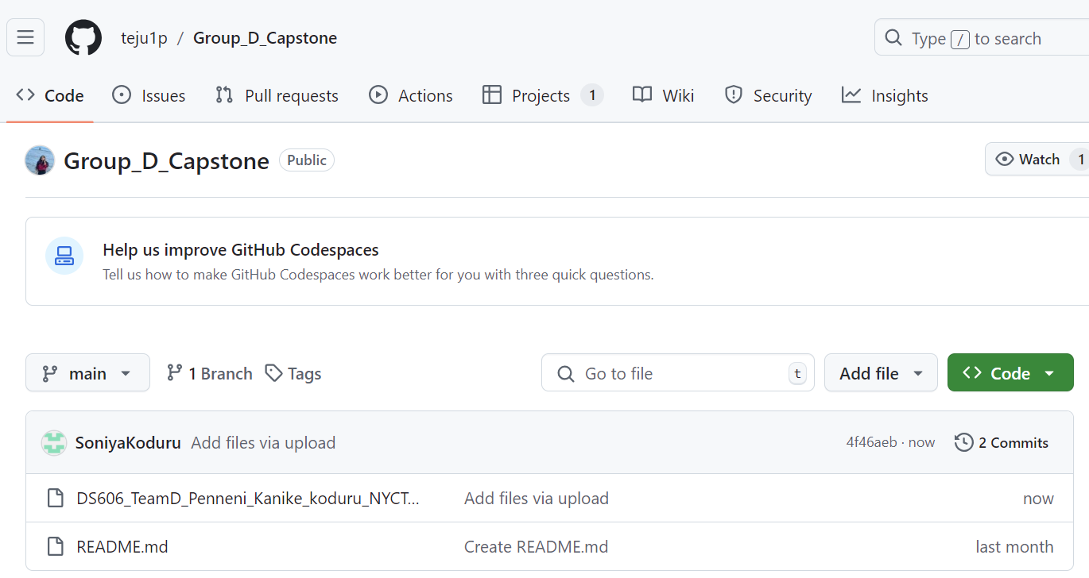
GitHub Account
https://github.com/teju1p/Group_D_Capstone

Slide 3
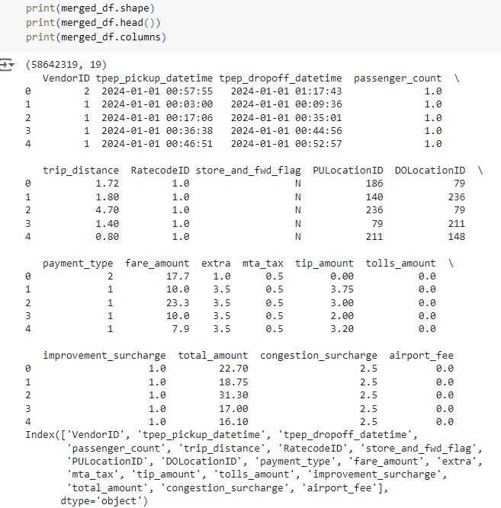
Dataset Overview
Source: NYC Taxi and Limousine Commission (TLC)
Link: https://www.nyc.gov/site/tlc/about/tlc-trip-record-data.page
Size: This dataset contains 19 columns and 58,642,319 rows, covering taxi rides from January 2023 to June 2024.
Task: Prediction (Fare, Duration) and Classification (Peak vs Off-peak hours)
Key Attributes: Pickup/Drop-off location, time, distance, fare, trip duration, airport fee etc.
Objective: Predict taxi fares and trip durations and classify peak hours using ML models with Streamlit integration for real-time user interaction.

Slide 4
Related Work & Our Approach
Study 1: NYC Taxi Trip Duration Prediction Using MLP and XGBoost
Predicted ride duration using XGBoost and MLP.
Used features like pickup/drop-off times, trip distance, and number of passengers.
Result: XGBoost provided better accuracy for trip time predictions.
Goal: Help users plan better to avoid surge pricing.
Study 2: Predicting NYC Taxi Trip Duration Using ML and Time Series Forecasting
Analyzed factors such as time of day, day of the week, and trip location.
Models: XGBRegressor and RNN.
Result: RNN outperformed XGBRegressor for time series forecasting.
Our Approach
Predicts taxi fares in addition to trip duration.
Introduces a peak vs. off-peak hour classification to aid trip planning.
Provides an interactive platform with real-time predictions using Streamlit.
Combines regression for fare and duration and classification for peak hours, offering a more complete, user-focused solution.

Slide 5
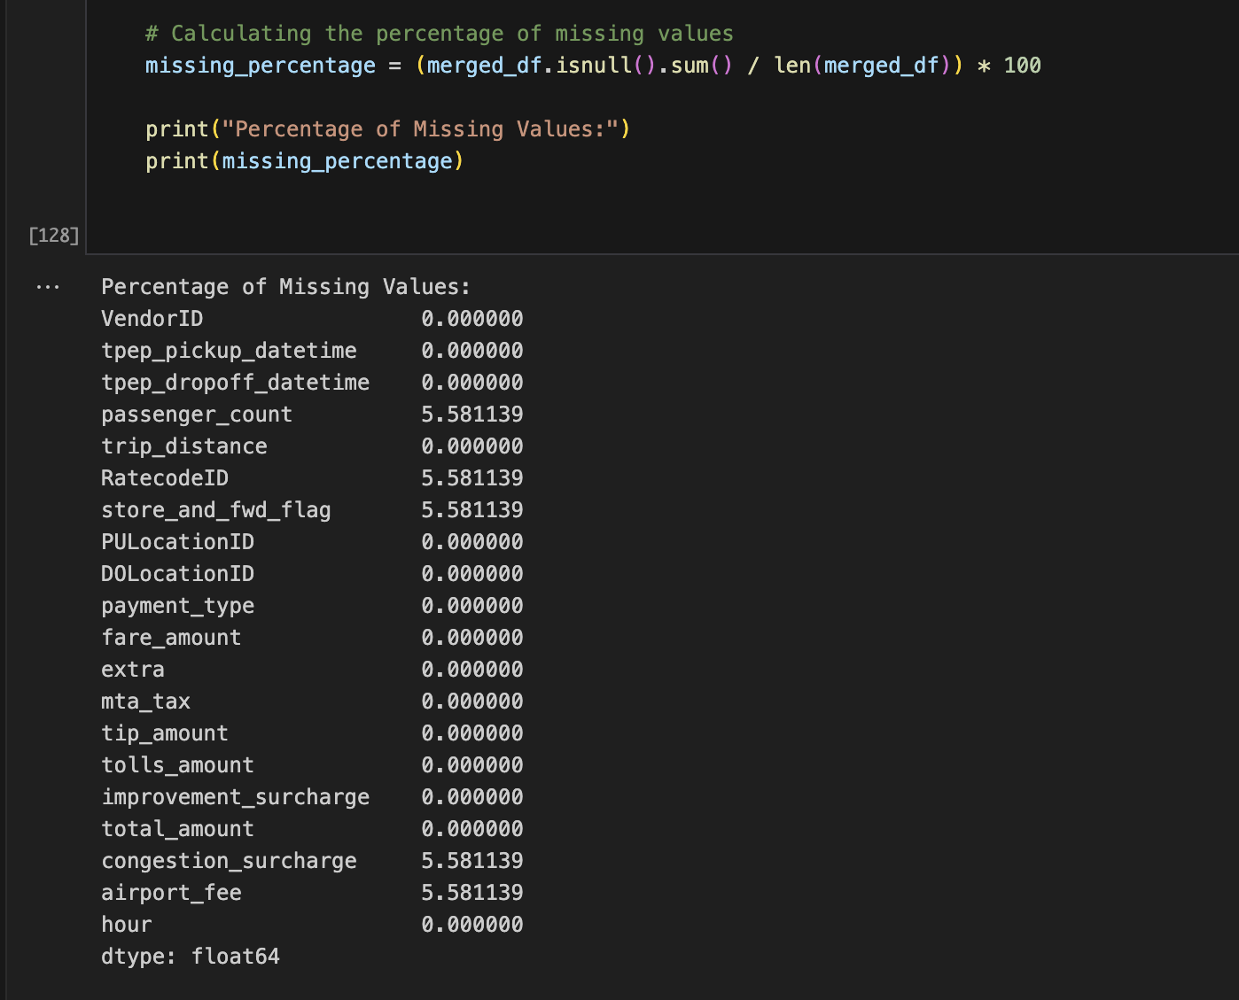
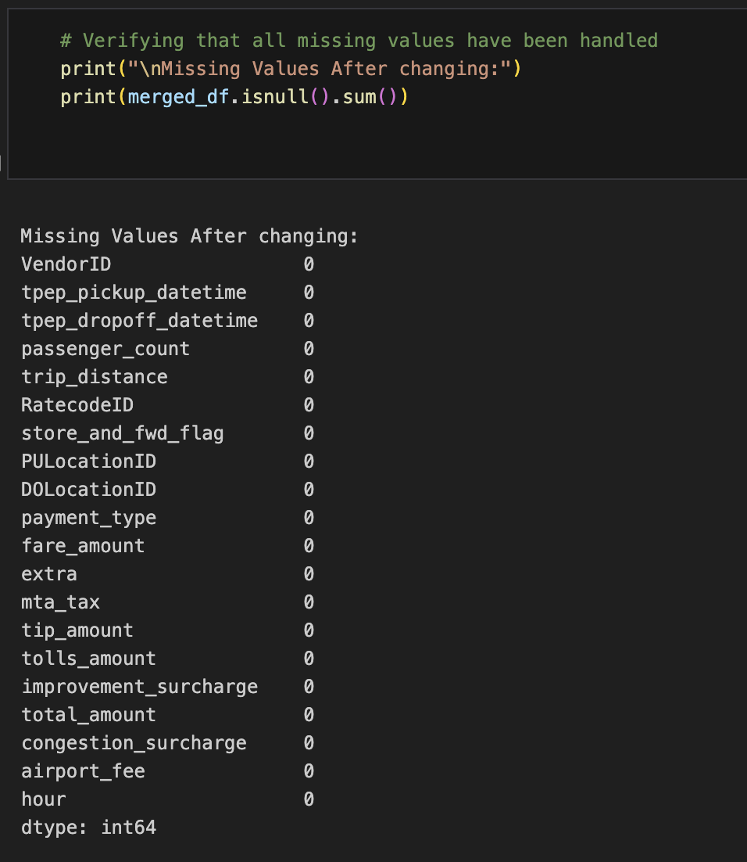
Exploratory Data Analysis
Missing Values: 5% missing data cleaned with imputation methods.

Slide 6
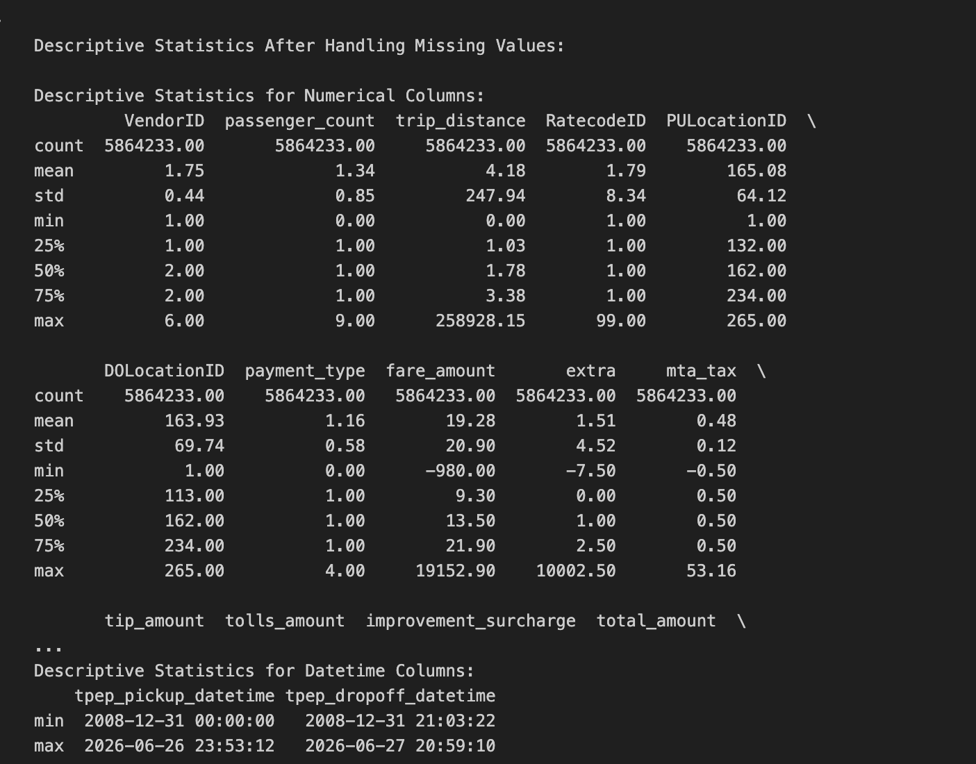
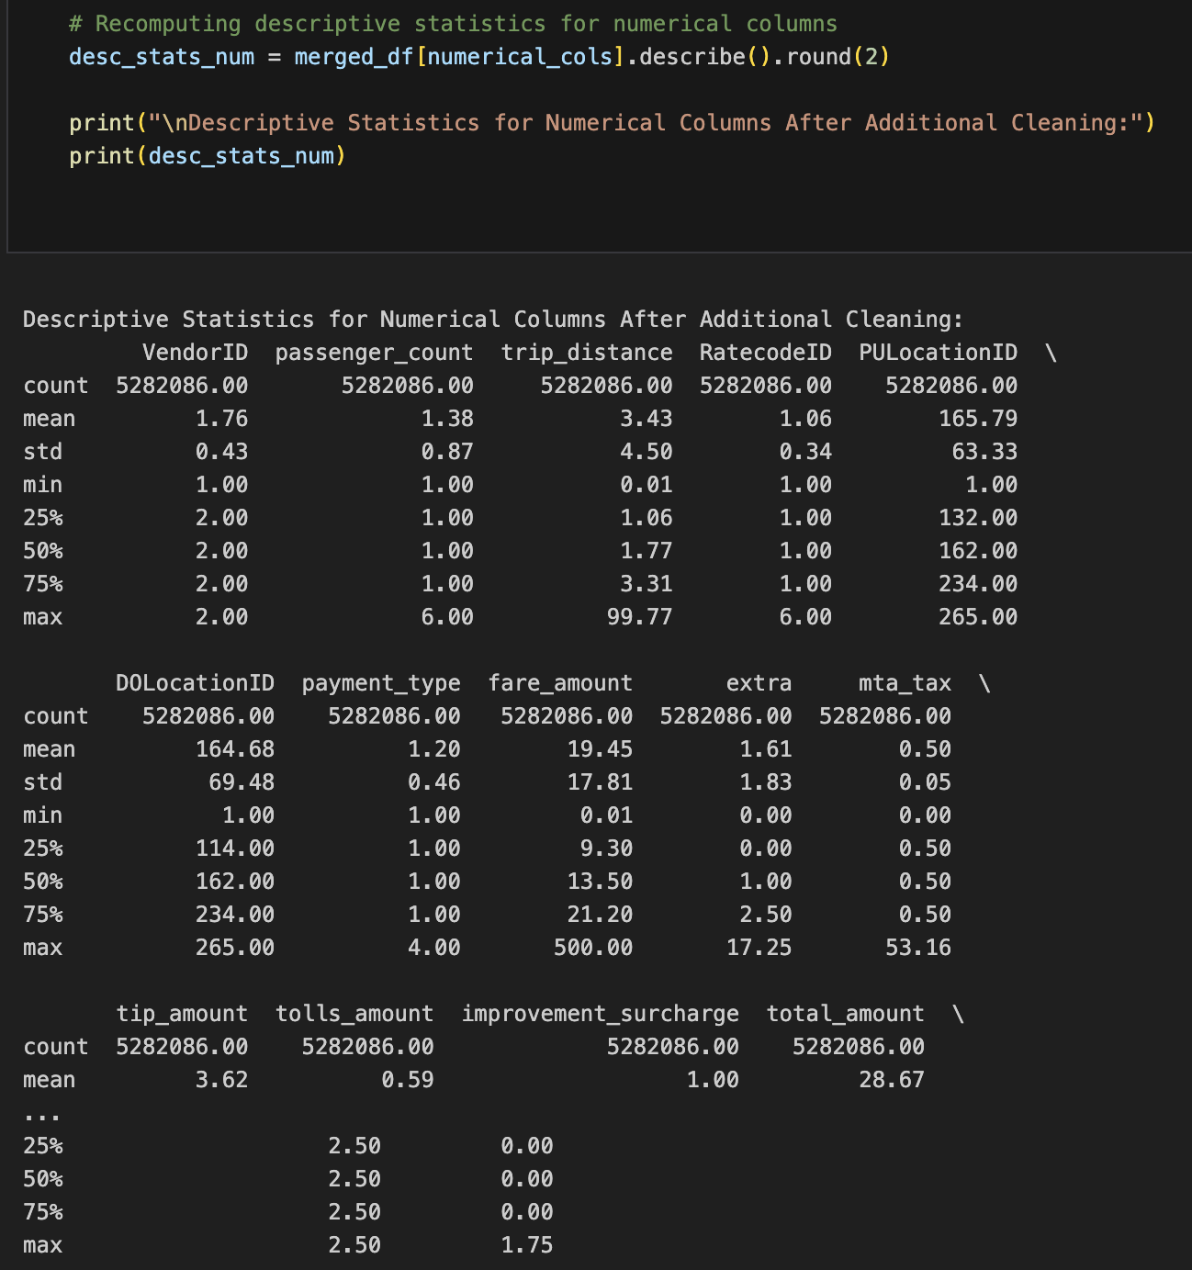
Descriptive statistics for dataset
Data Cleaning:
Anomaly detection : Removal or replacement ( Negative values in fare amount / trip duration /tip / toll charges ; 0 passenger count etc.

Slide 7
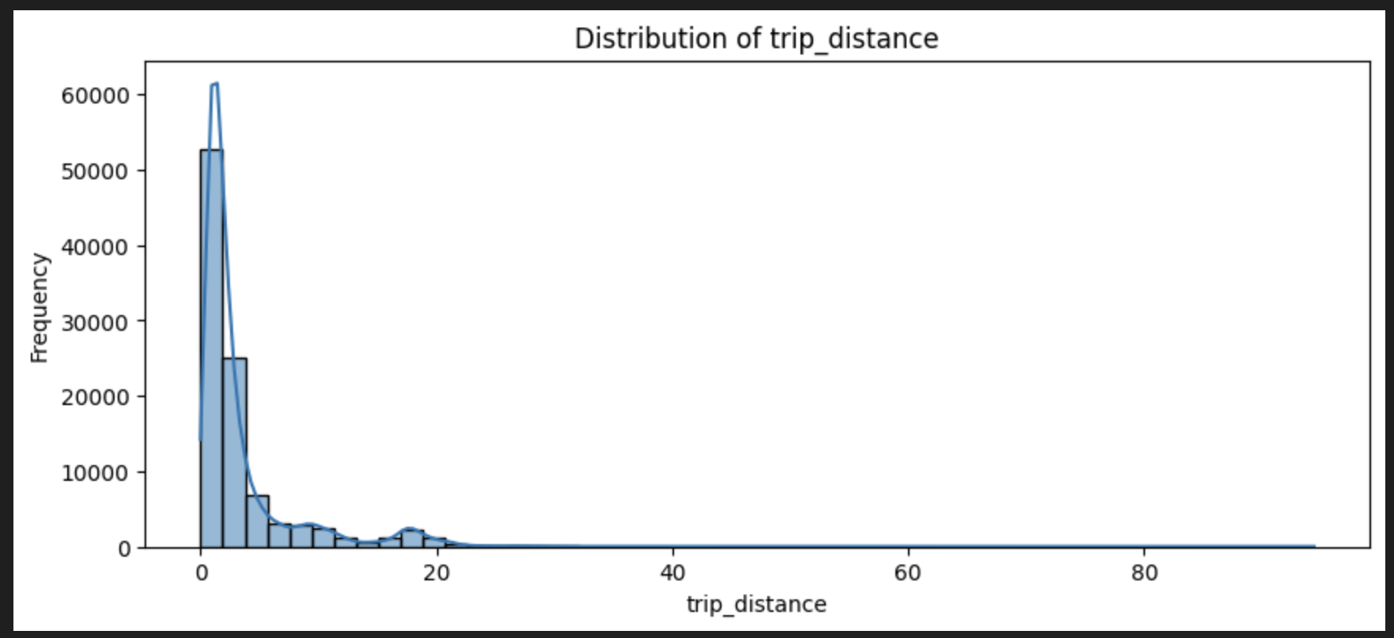
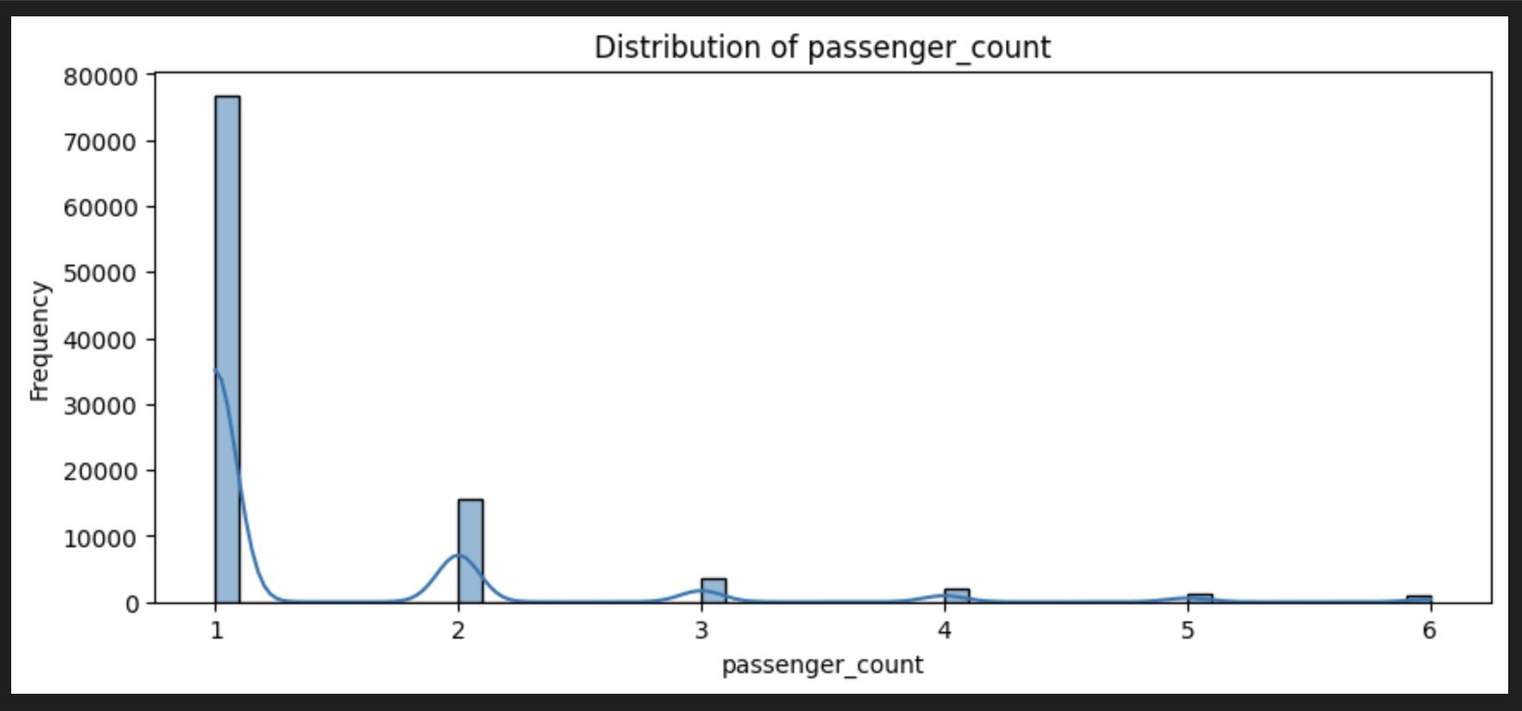
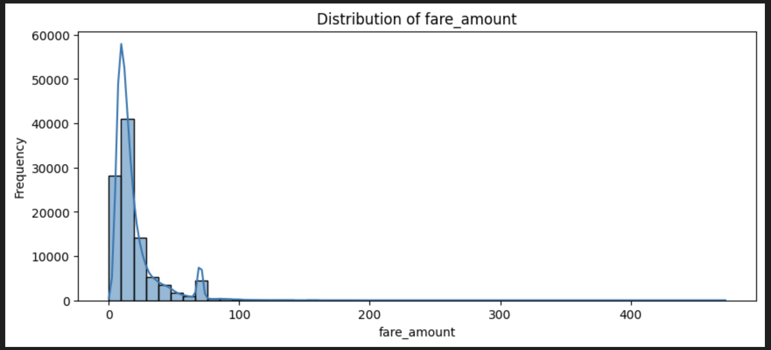
EDA
Majority of the Taxi Trips are with 1 passenger, trip distance between 0 to 20 miles and fare amount less than 100$

Slide 8
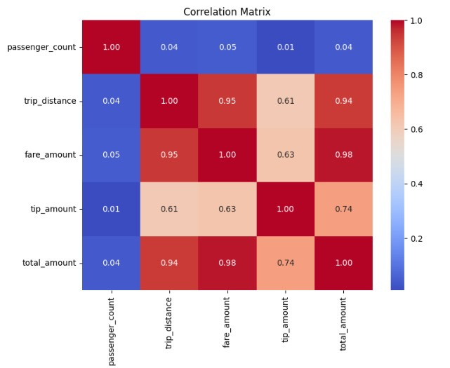
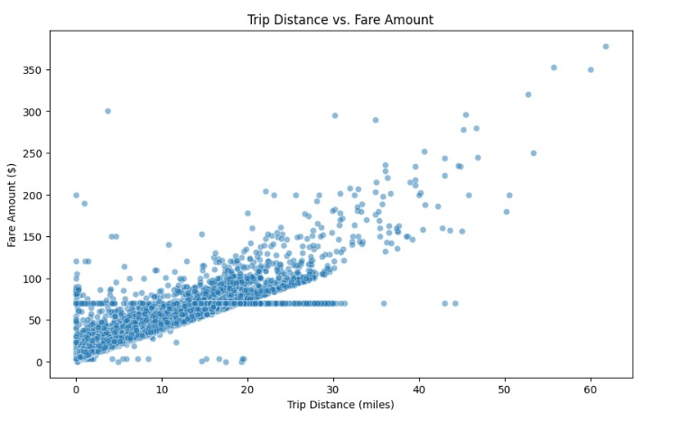
EDA – Feature Engineering & Correlation Matrix
Implemented Feature engineering to identify trip duration, Weekday/Weekend etc. and mapped pick up and drop off borough / zone. Also presented the correlation matrix and a scattered plot of trip fare amount vs distance

Slide 9
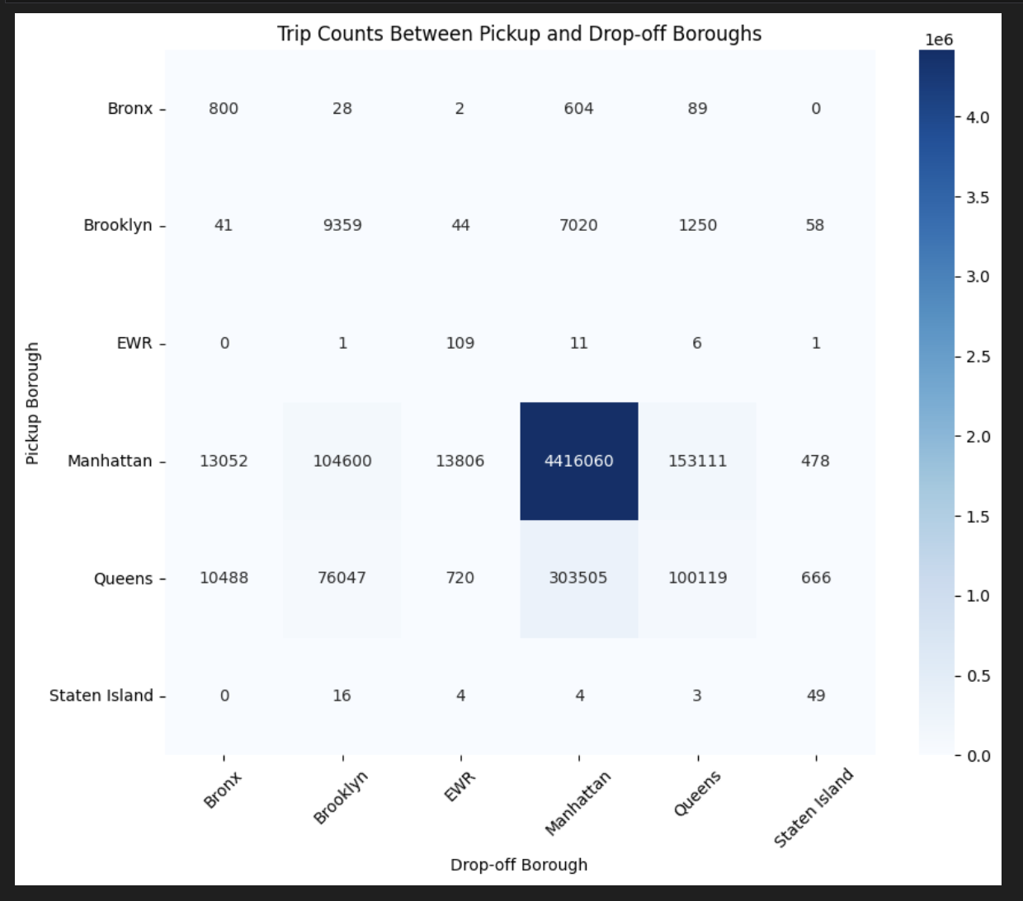
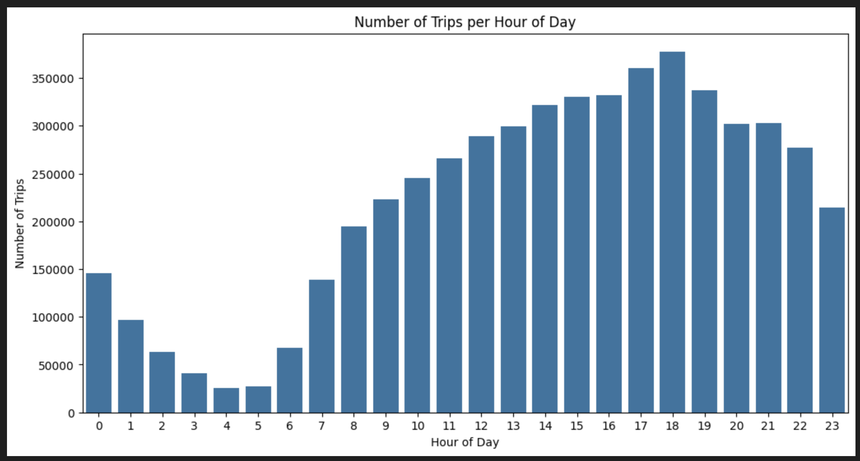
EDA – Trip counts per hour & between pick up and drop off boroughs

Slide 10
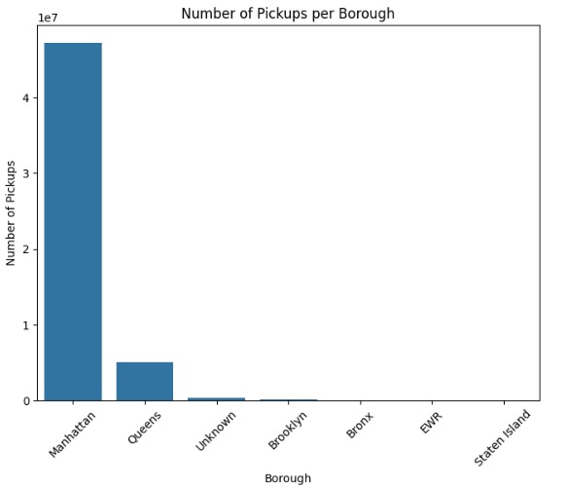
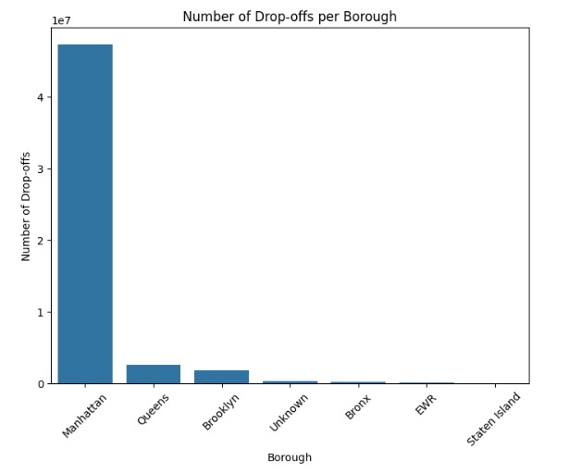
EDA –Count of pick ups and drop offs in respective boroughs

Slide 11
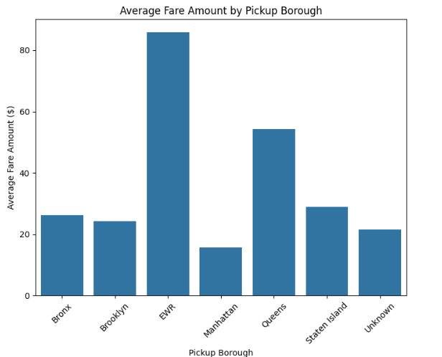
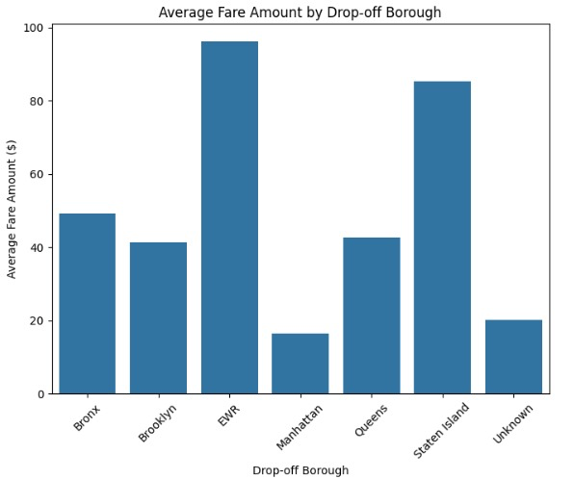
EDA –Average fare amount by pick ups and drop offs in respective boroughs

Slide 12
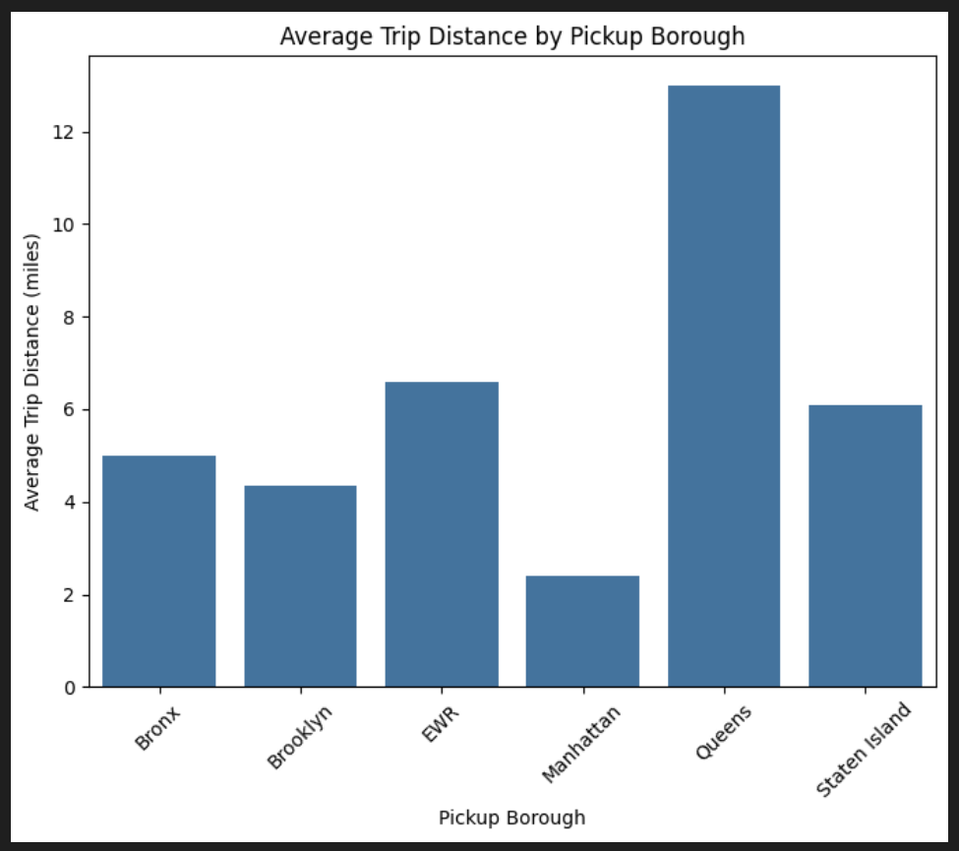
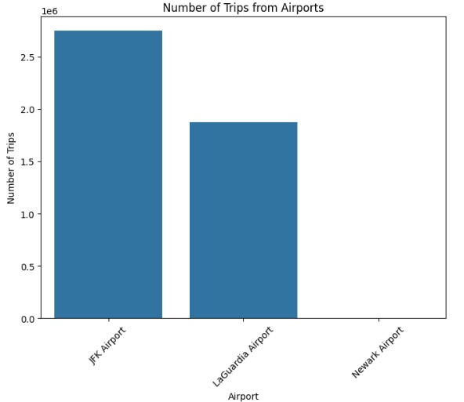
EDA – Average trip distance and number of trips from airports

Slide 13
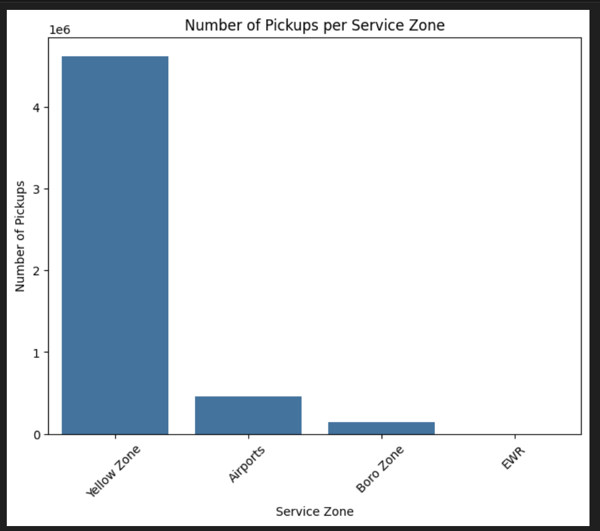
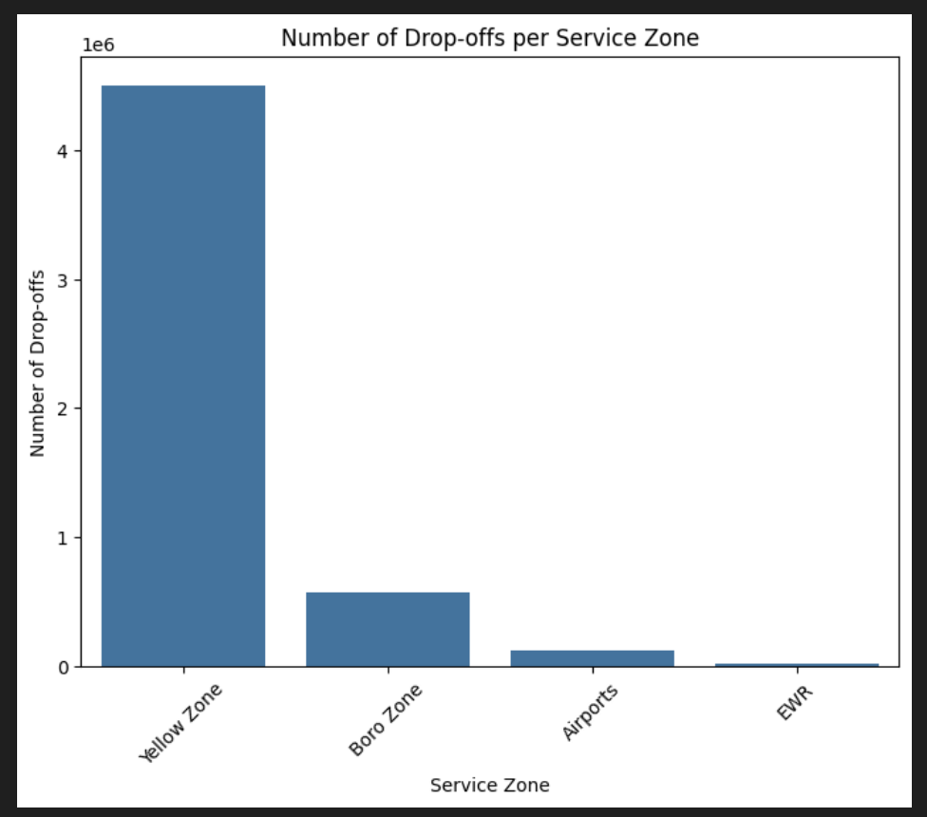
EDA – Count of pick ups & drop offs in respective service zone

Slide 14
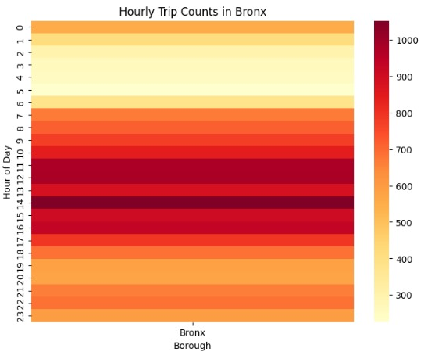
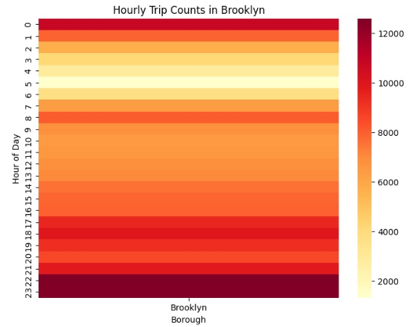
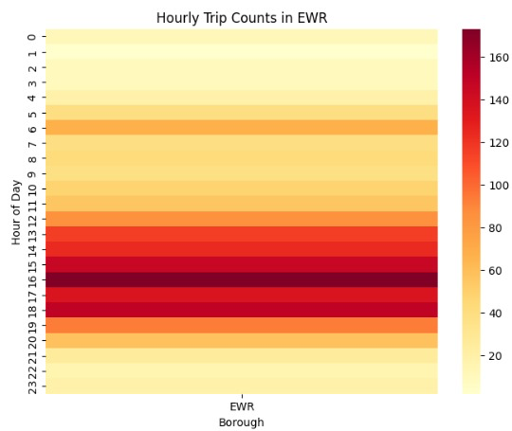
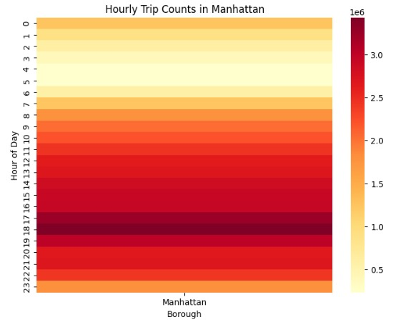
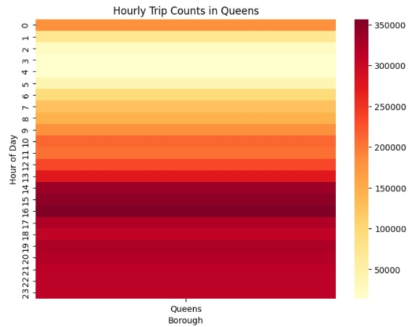
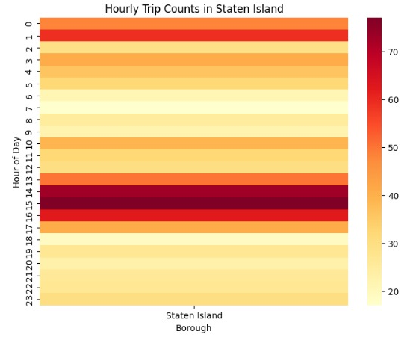
EDA -Heat Maps for Hourly Trip counts from different pickup Boroughs

Slide 15
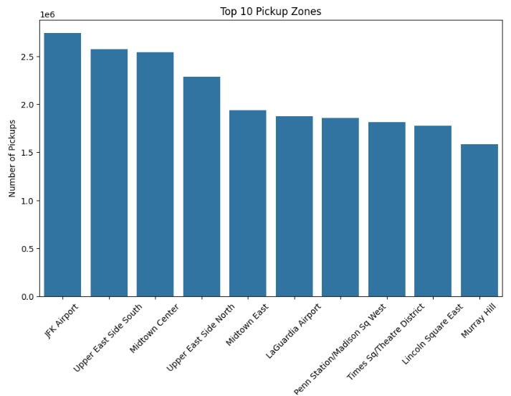
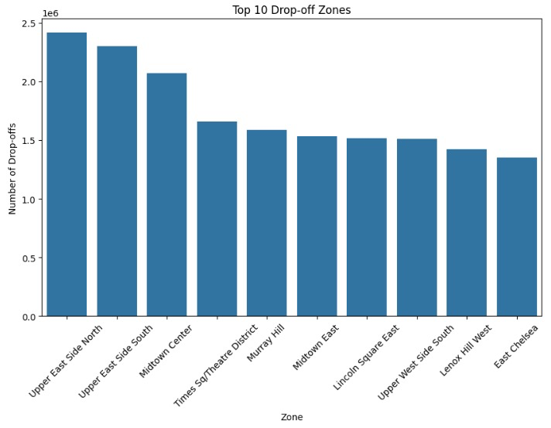
EDA – Top 10 pick up and drop off zones
These graphs shows that top pickup and drop off zones in NYC, where we can observe that most of the pickups from JFK Airport and drop-offs from Upper east Side North

Slide 16
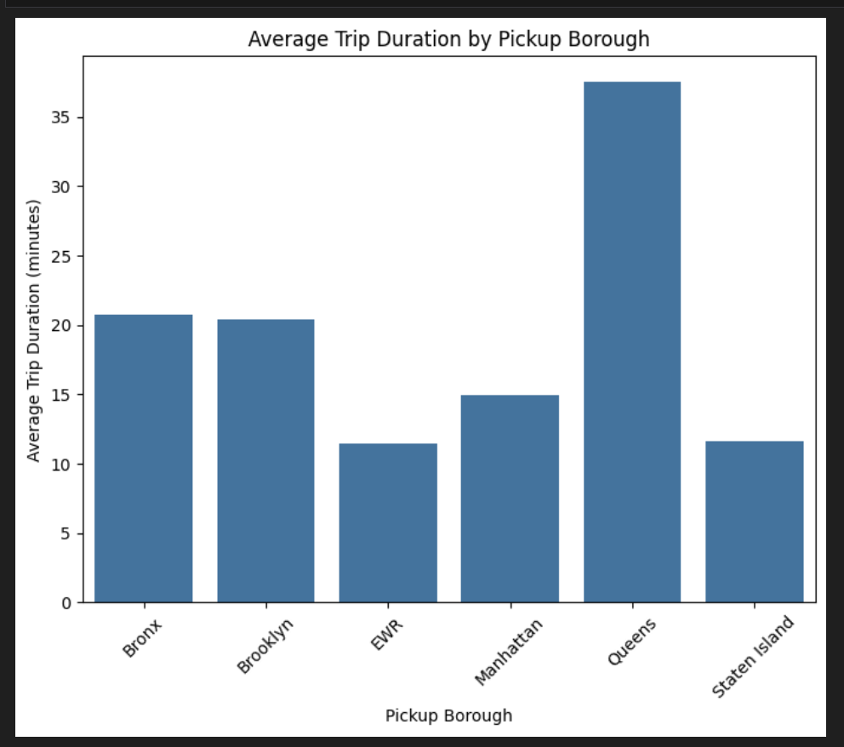
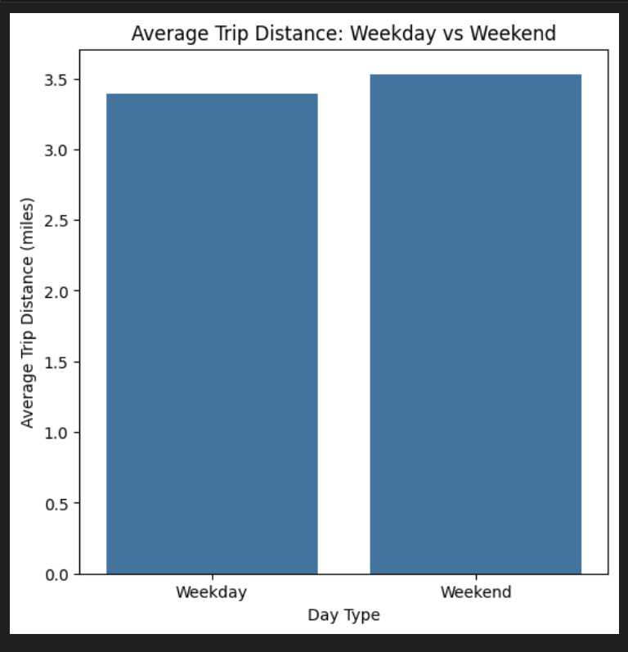
EDA – Average trip duration and weekday vs weekend trip distance

Slide 17
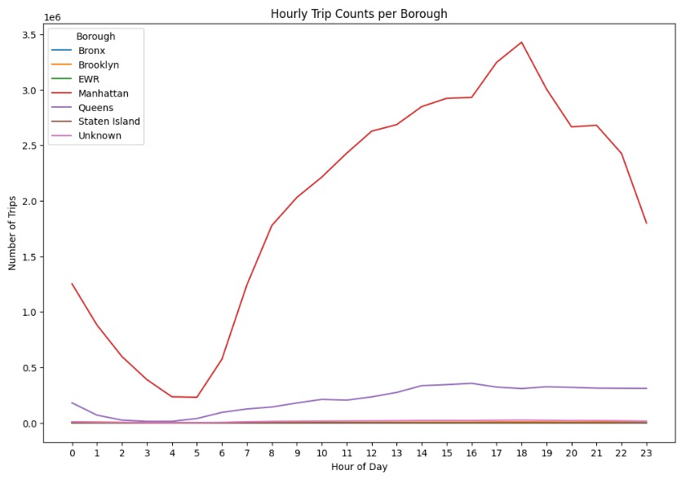
EDA – Hourly trip counts
This graph illustrating the number of trips throughout the day for different boroughs in New York City.

Slide 18
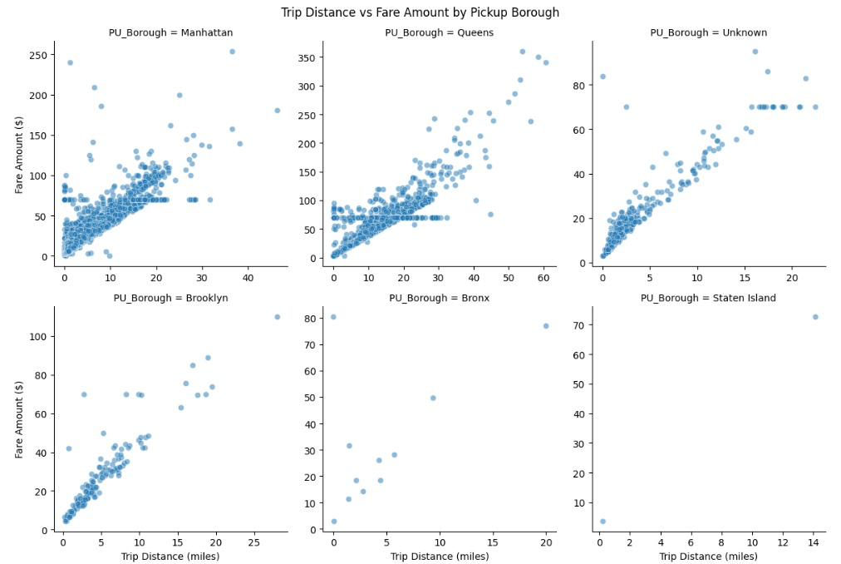
EDA – Hourly trip counts
Scatter Plots for trip distance trip distance (in miles) and fare amount (in dollars) for taxi rides across different boroughs

Slide 19
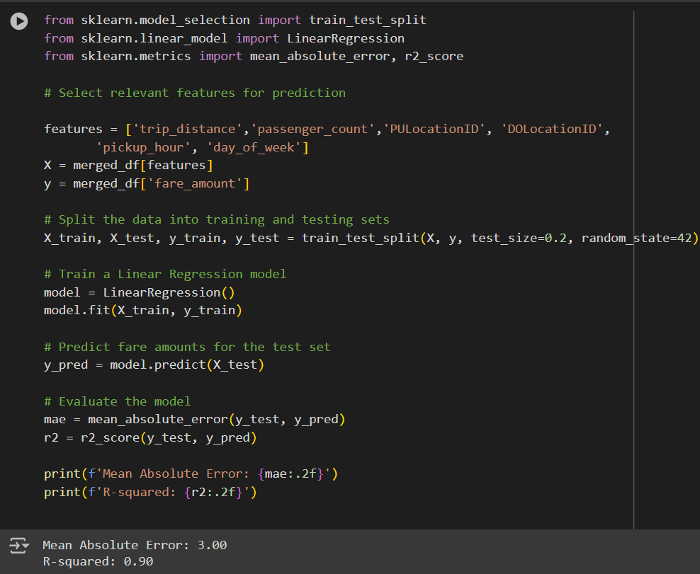
Model selection
Model : Linear Regression
Features :
'trip_distance’
'passenger_count’
'pickup_hour’
'trip_duration’
Evaluation Metrics :
Mean Absolute Error: 2.95
R-squared: 0.90

Slide 20
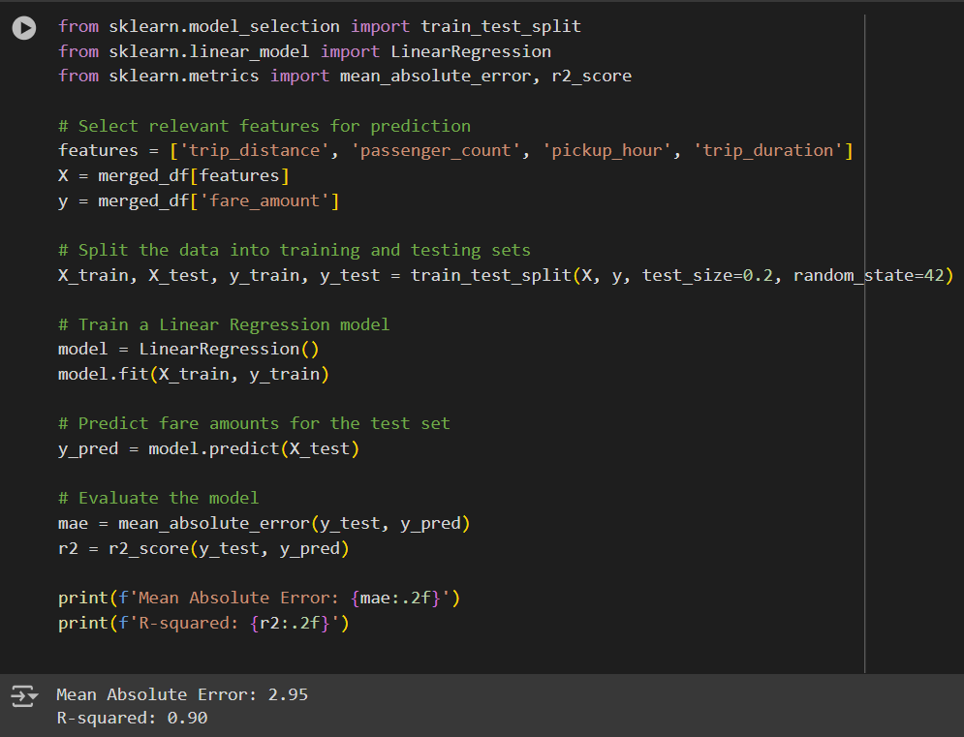
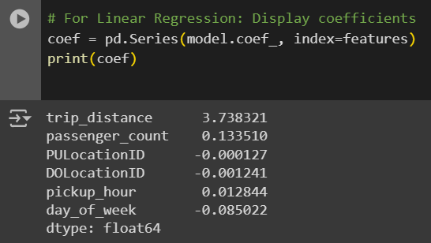
Model selection
Model : Linear Regression
Features :
'trip_distance’,
'passenger_count’
'PULocationID’
'DOLocationID’
'pickup_hour’
'day_of_week’
Evaluation Metrics :
Mean Absolute Error: 3
R-squared: 0.90

Slide 21
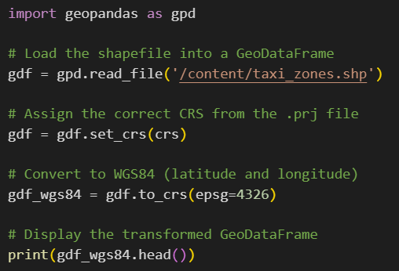
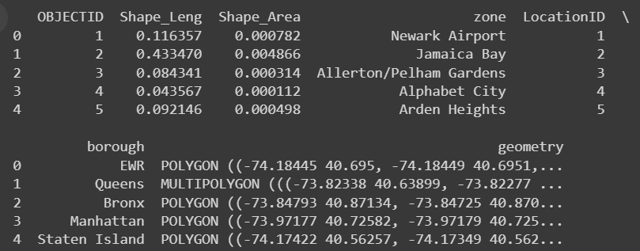
Feature Engineering – Identifying pick up and drop off locations Latitude & longitude for trip
Identified pick up and drop off locations Latitude & longitude using Geopandas.

Slide 22
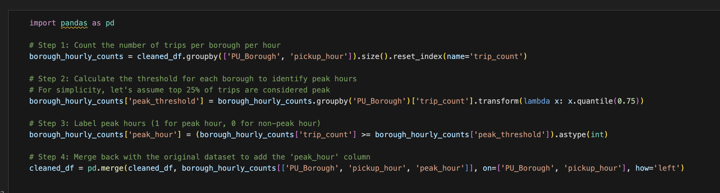
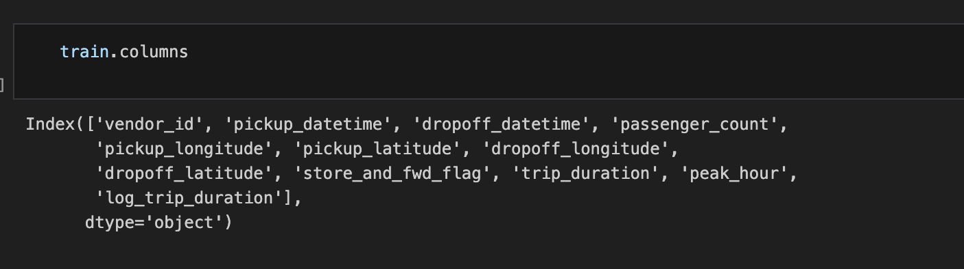
Peak hour Classification

Slide 23
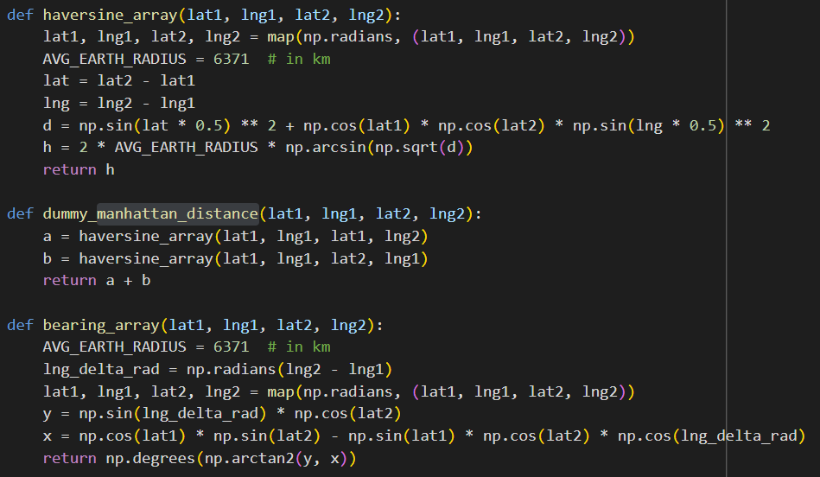
Feature Engineering
Calculating haversine , Manhattan distance and direction to get the average speed

Slide 24
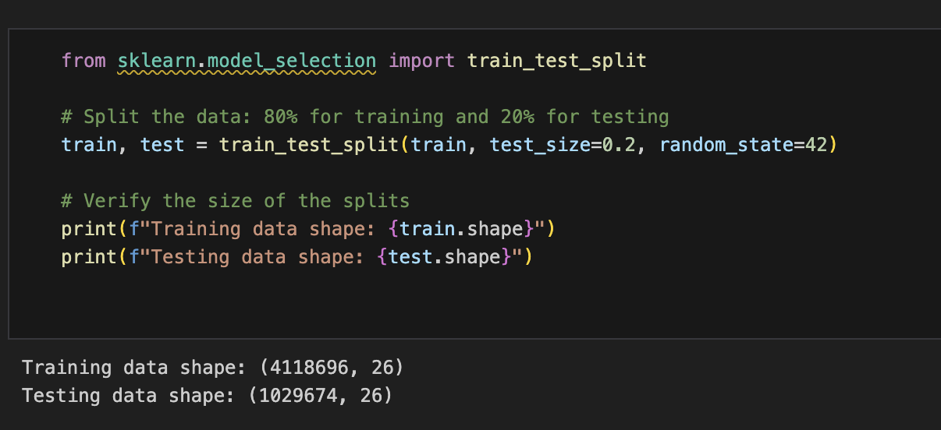
Spitting the data into train & test

Slide 25
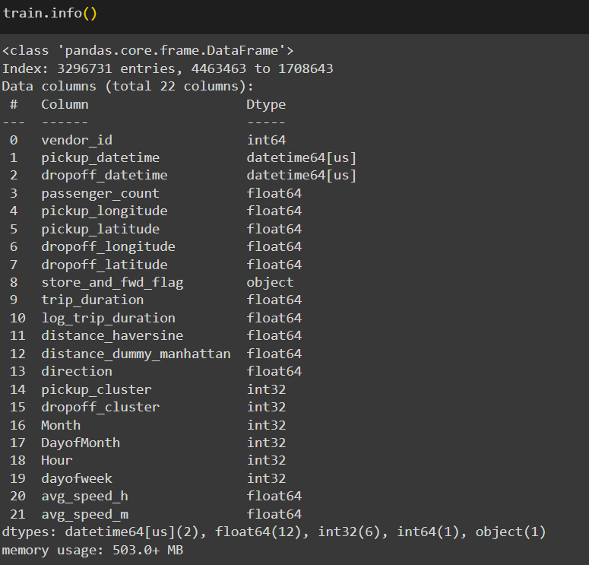
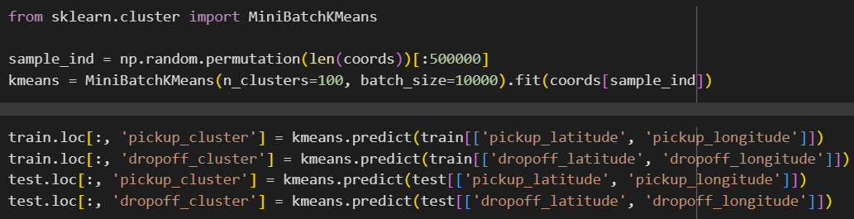
Clustering the location as per latitude & longitude
Columns of dataset
Calculating Average speed

Slide 26
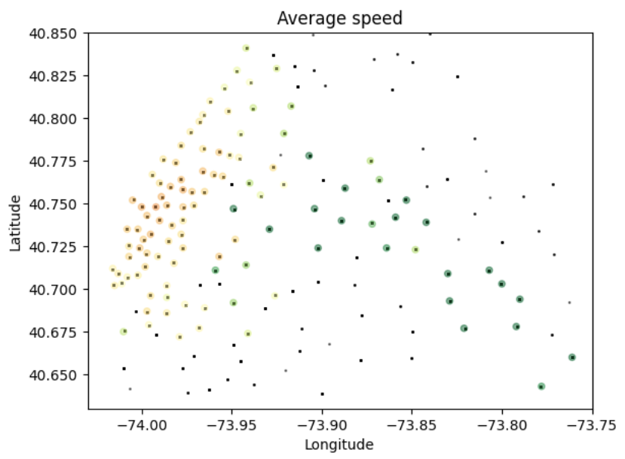
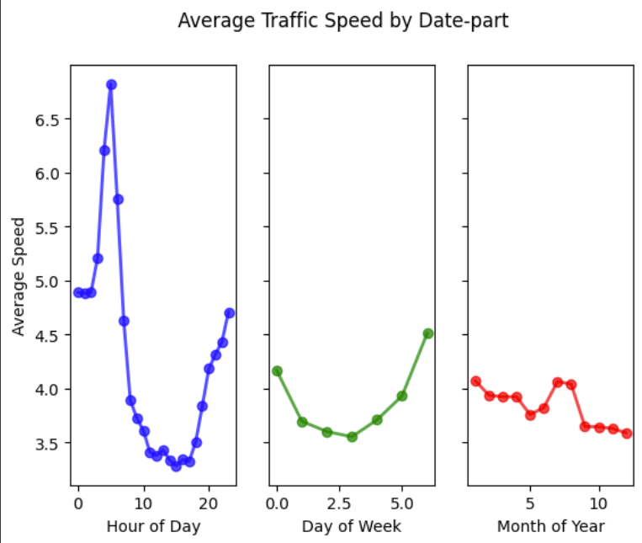
Feature Engineering
Average speed variation with location, respect to hour of day, day of week and month of year

Slide 27
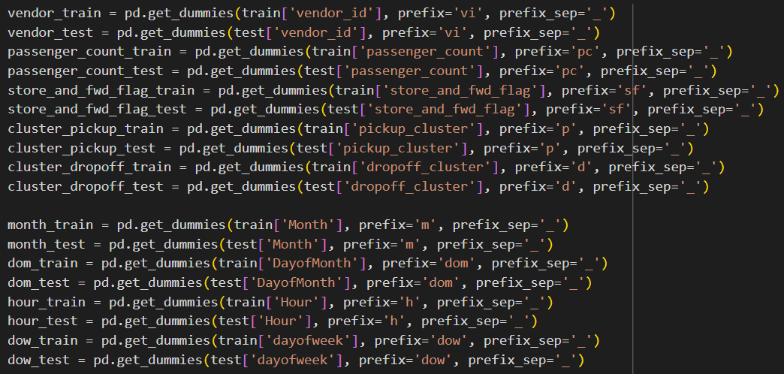
One hot encoding
One hot encoding for all the relevant features

Slide 28
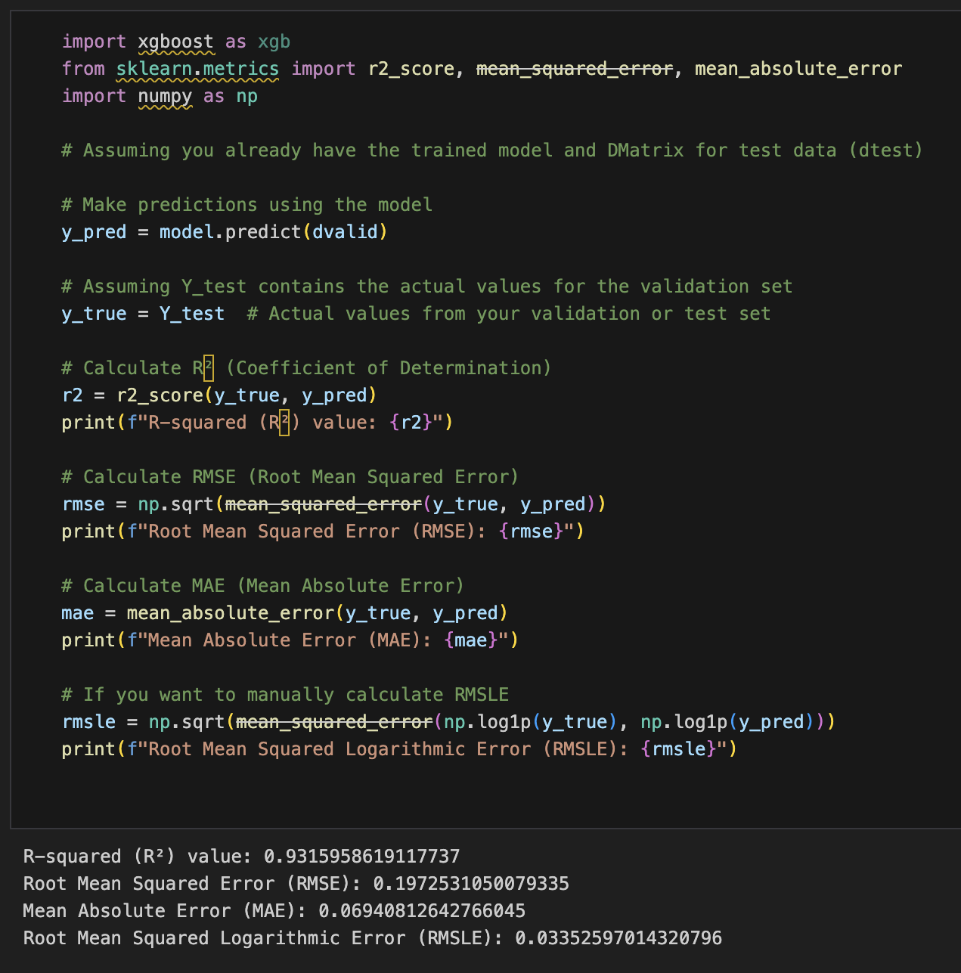
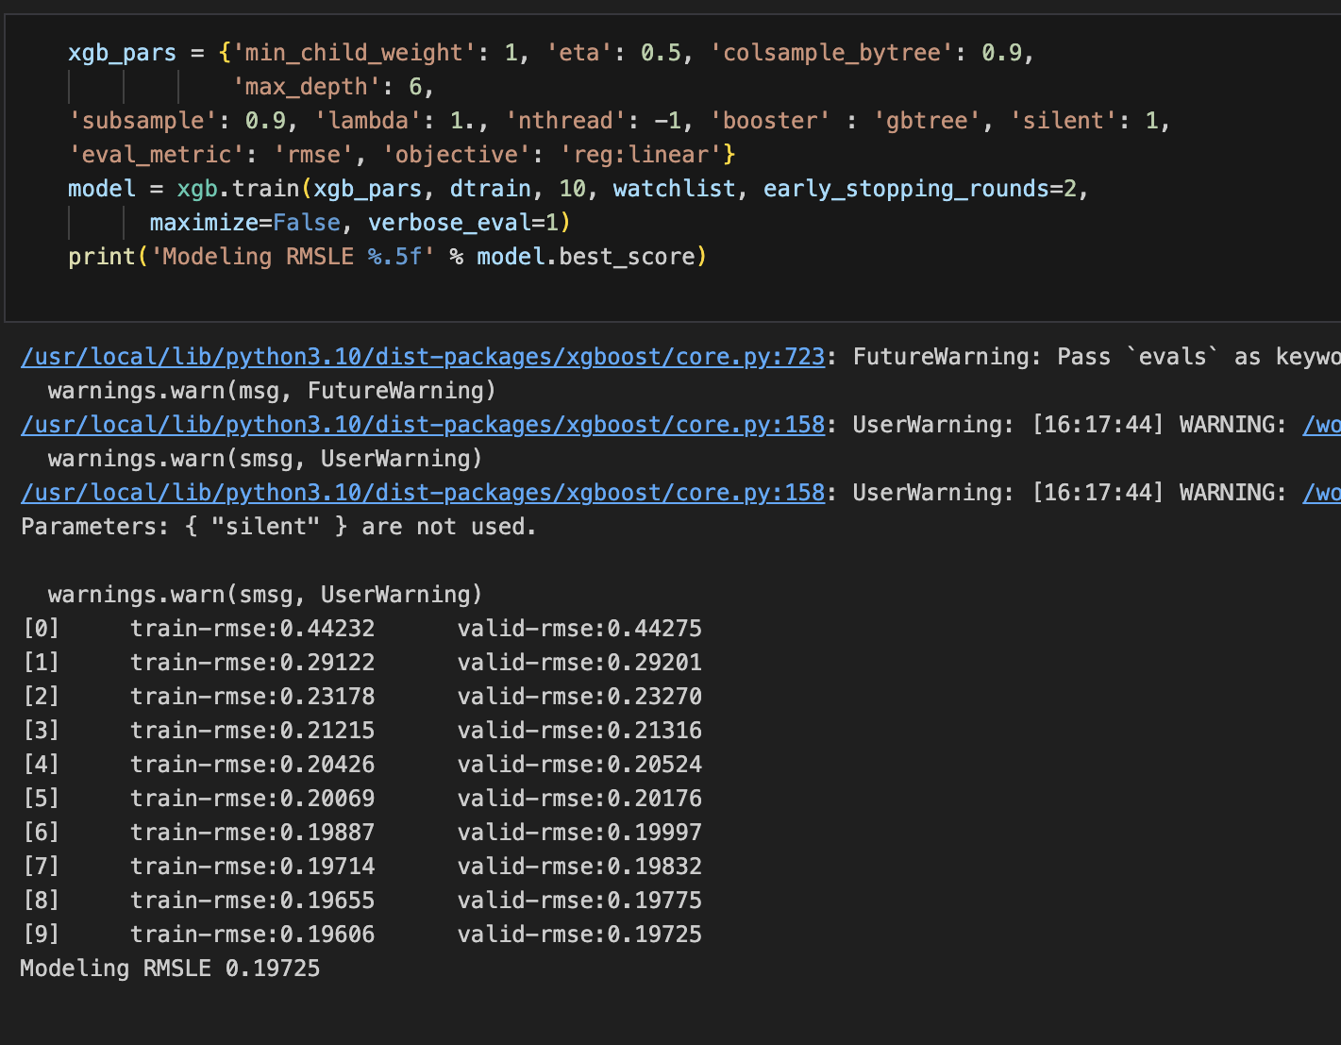
XGBoost Model Development

Slide 29
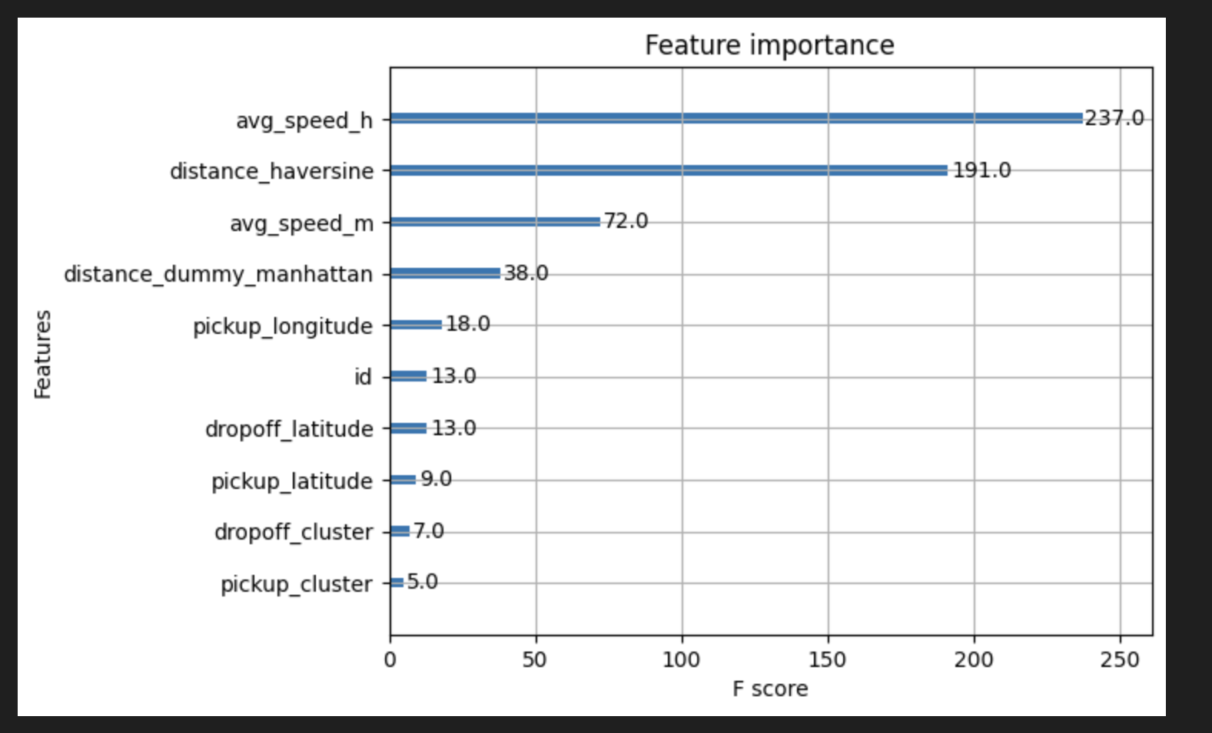
Feature Importance score

Slide 30
Conclusion
We have made significant progress by cleaning our dataset, performing exploratory data analysis, feature engineering and model development. Our next steps creating a user-friendly web interface to deliver accurate fare and duration predictions, along with peak hour classifications.

Slide 31
References
https://www.nyc.gov/site/tlc/about/tlc-trip-record-data.page
Poongodi, M., Malviya, M., Kumar, C. et al. New York City taxi trip duration prediction using MLP and XGBoost. Int J Syst Assur Eng Manag 13 (Suppl 1), 16–27 (2022). https://doi.org/10.1007/s13198-021-01130-x
Ramani, S., Ghiya, A., Aravind, P.S., Karuppiah, M., Pelusi, D. (2022). Predicting New York Taxi Trip Duration Based on Regression Analysis Using ML and Time Series Forecasting Using DL. In: Raj, J.S., Shi, Y., Pelusi, D., Balas, V.E. (eds) Intelligent Sustainable Systems. Lecture Notes in Networks and Systems, vol 458. Springer, Singapore. https://doi.org/10.1007/978-981-19-2894-9_2

Slide 32
THANK YOU

